Slide 1
IBAMR Tutorial: Changing springs and target points

Slide 2
Moving boundaries
You can make boundaries actively move using
Target points to provide a preferred motion
Springs whose stiffness or resting lengths change in time
Beams whose resting curvature changes in time
Muscle models / muscle springs

Slide 3
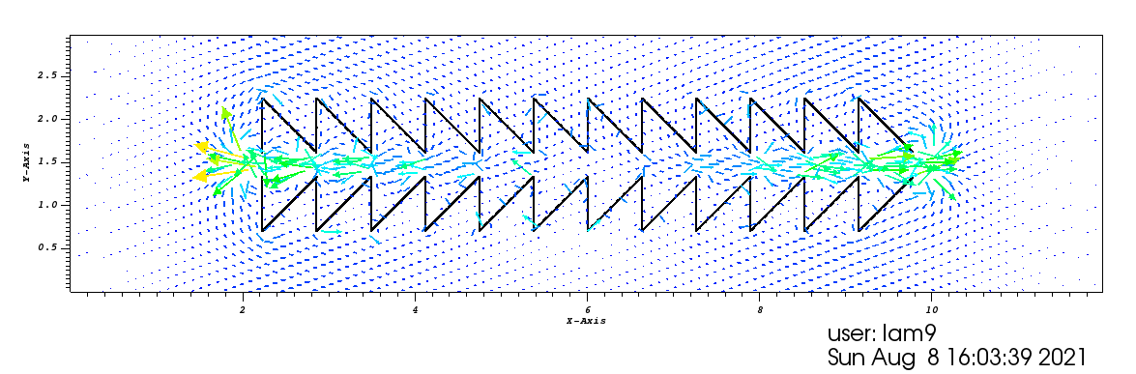
IB2d – Example Sawtooth
Vertices make up a saw tooth channel.
The top of the channel moves up and down to drive flow.
Target points are used to impose a preferred motion.
The bottom of the channel does not move.

Slide 4
Generate_mesh, or give_Me_Sawtooth_Geometry
Lx = 12; % Length of Computational Domain in X (m)
Ly = 3.0; % Length of Computational Domain in Y (m)
Nx = 1024; % Grid Resolution in X
Ny = 256; % Grid Resolution in Y
ds = Lx/(2.1*Nx); % Makes Lagrangian Spaced based on 512x512 finest grid
Note that Nx and Ny are different given that Lx and Ly are not equal
They are chosen so that dx = dy.
ds is a little bit less than dx/2, this was probably a choice by Nick to tweak the simulation.

Slide 5
Generate_mesh, or give_Me_Sawtooth_Geometry
% Geometric Parameters
d = 0.63; % height of tooth
w = 0.63; % width of tooth
G = 0.325; % vertical distance between teeth (gap)
%
% Gives Sawtooth Geometry
%
[xLag, yLag] = give_Me_Lagrangian_Geometry(ds,d,w,G);
xLag = xLag + ( Lx/2- xLag(end/4) ); % shift geometry to center of domain
yLag = yLag + ( Ly/2 ); % shift geometry accordingly to center of domain
Custom code written by Nick to generate the sawtooth geometry.
Also makes a plot of the geometry to check

Slide 6
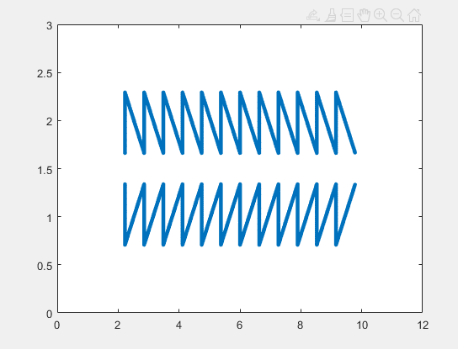
Information that is printed
Info for Update_Target_Point_Positions():
G = 3.250000e-01 (vertical gap btwn top and bottom)
N_Top = 3276 (# of points on top of sawtooth)
This information is important, and if you change the geometry or the resolution, you need to update the function Update_Target_Point_Positions(): manually.
This is because you need to loop through all vertices and determine which to move (1-3276) and which to not move (3277-6552).

Slide 7
update_Target_Point_Positions
function targets = update_Target_Point_Positions(dt,current_time,targets)
Function reads in the time step, current time, and target points information.
Function returns updated target point information.
yPts= targets(:,3); % Previous y-Values of y-Target Pts
We are only modifying the y-values, which are stored in the third column.
The lagrangian IDs are in the first column, and the x- positions are in the second. The fourth column stores the spring stiffnesses.
N_top = 3276; % # of points along top
Look at the sawtooth.target file. There are 6552 points. 1-3276 are the top of the sawtooth, 3277-6552 are the bottom.

Slide 8
update_Target_Point_Positions
yPTS = read_In_yPT_Positions('sawtooth.vertex');
This code is written such that the new positions are calculated using the original positions. You could also modify based on the position from the previous time step.
targets(1:N_top,3) = yPTS(1:N_top) - (a/2)*sin( 2*pi*freq*current_time );
Note that we are only modifying target points 1-N_top, representing the top of the sawtooth.
Recall that the third column are the y-positions.
Note that if you change the resolution, geometry, etc. you will need to update N_top in this file.
To move the bottom, you would want to do something like the following ---
targets(N_top+1:2*N_top,3) = yPTS(N_top+1:2*N_top) + movement_function.

Slide 9
update_Target_Point_Positions
%IDs = targets(:,1); % Stores Lag-Pt IDs in col vector
%xPts= targets(:,2); % Previous x-Values of x-Target Pts.
yPts= targets(:,3); % Previous y-Values of y-Target Pts.
%kStiffs = targets(:,4); % Stores Target Stiffnesses
%N_target = length(targets(:,1)); % Gives total number of target pts!
Note the only thing read in are the previous y-Values of y-Target points.
We actually don’t use these values those because of this line –
yPTS = read_In_yPT_Positions('sawtooth.vertex’);
Nick likely changes the way the movement was handled.

Slide 10
update_Target_Point_Positions
% PUMPING PARAMETERS
%
freq = 2; % pumping frequency
%G = 0.325; % vertical gap between teeth
%occ = 0.95; % occlusion total
a = 0.337; % total vertical distance pump travels
N_top = 3276; % # of points along top
You need to update N_top if you change the resolution or geometry.
You may also need to change a, the total vertical distance the pump travels.
The gap is 0.325, and the pump will move down by a/2. Make sure the top and bottom don’t collide.

Slide 11
update_Target_Point_Positions
% Create the pumping behavior
%
targets(1:N_top,3) = yPTS(1:N_top) - (a/2)*sin( 2*pi*freq*current_time );
In this line, we are changing the y-positions of the target points.
Note we only change 1-N_top.
We shift the position from the original y-coordinate:
yPTS = read_In_yPT_Positions('sawtooth.vertex’);
The shift is - (a/2)*sin( 2*pi*freq*current_time );

Slide 12
Sawtooth.vertex
6552
2.2241789313828884e+00 1.6625000000000001e+00
2.2241789313828884e+00 1.6680803571428571e+00
2.2241789313828884e+00 1.6736607142857143e+00
2.2241789313828884e+00 1.6792410714285715e+00
2.2241789313828884e+00 1.6848214285714285e+00
2.2241789313828884e+00 1.6904017857142857e+00
2.2241789313828884e+00 1.6959821428571429e+00
2.2241789313828884e+00 1.7015625000000001e+00
2.2241789313828884e+00 1.7071428571428571e+00
2.2241789313828884e+00 1.7127232142857143e+00
2.2241789313828884e+00 1.7183035714285715e+00
…….

Slide 13
sawtooth.target
6552
1 1.0000000000000000e+11
2 1.0000000000000000e+11
3 1.0000000000000000e+11
4 1.0000000000000000e+11
5 1.0000000000000000e+11
6 1.0000000000000000e+11
7 1.0000000000000000e+11
8 1.0000000000000000e+11
9 1.0000000000000000e+11
10 1.0000000000000000e+11
11 1.0000000000000000e+11
12 1.0000000000000000e+11
13 1.0000000000000000e+11
14 1.0000000000000000e+11
15 1.0000000000000000e+11
16 1.0000000000000000e+11
17 1.0000000000000000e+11
18 1.0000000000000000e+11
19 1.0000000000000000e+11
20 1.0000000000000000e+11
21 1.0000000000000000e+11
…..

Slide 14
IBAMR: Simple example to move target points
Example: Moving Cylinders
A line of cylinders (forming a holey plate) is tethered to target points that translate it.
The relevant files are update_target_point_positions.C and update_target_point_positions.h

Slide 15
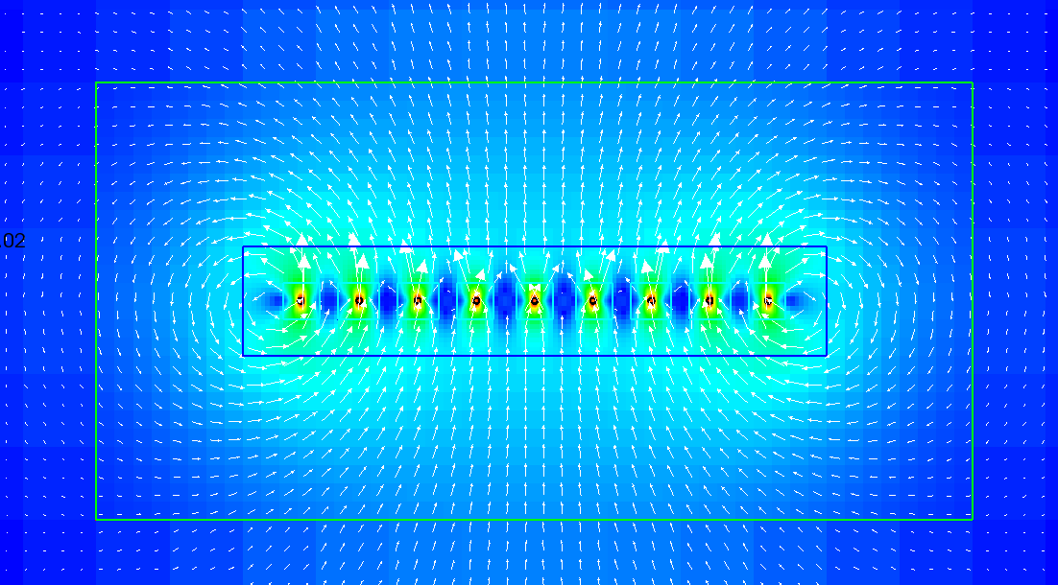
Moving cylinders: Magnitude of Velocity

Slide 16
From IBAMR FAQ
There is a routine (update_target_point_positions) that loops over the local IB points (i.e., the IB points that are "local to the processor"). The pseudo-code is roughly:
for each local IB point { check to see if the point has a target point spec if yes: update the material properties w/that target spec }
The properties for the target points are stored in IBTargetPointForceSpec objects. Functionality has been added to the most recent IBAMR versions to simplify the code required to access these objects. In particular, for each Lagrangian (IB) point, you can do:
tbox::Pointer<T> spec = node_idx.getStashData<T>();
to get a pointer to any object of type T that is associated with the Lagrangian point.

Slide 17
update_target_positions.C
update_target_point_positions(
tbox::Pointer<hier::PatchHierarchy<NDIM> > hierarchy,
LDataManager* const l_data_manager,
const double current_time,
const double dt)
You have access to the current_time and time step (dt).
You also have access to the patch hierarchy and can get the nodes the particular processor is working on.

Slide 18
update_target_point_position example
const std::pair<int,int>& wing_lag_idxs = l_data_manager->getLagrangianStructureIndexRange(0, finest_ln);
//wing_lag_idxs.first is the first point on the wing. If you have more than one boundary, you can use this to determine which boundary you are on.
for (vector<LNode*>::iterator it = nodes.begin(); it != nodes.end(); ++it)
//loops over all of the nodes
IBTargetPointForceSpec* force_spec = node_idx->getNodeDataItem<IBTargetPointForceSpec>()
//get data from the target point, such as its position.
if (force_spec == NULL) continue;
//check if there is a target point associated with the node.
const int lag_idx = node_idx->getLagrangianIndex();
//get the Lagrangian index for that node

Slide 19
update_target_point_position example
//Depending on the version of IBAMR, you need to select one of the ways of accessing target point positions
//TinyVector<double,NDIM>& X_target = force_spec->getTargetPointPosition();
//IBTK::Vector<double,NDIM>& X_target = force_spec->getTargetPointPosition();
Point& X_target = force_spec->getTargetPointPosition();
//get the target point position since we are going to modify it.
if (current_time <= time_to_acc)
//check to see if we are in the acceleration phase of the wing.
if (wing_lag_idxs.first <= lag_idx && lag_idx < wing_lag_idxs.second)
//check to see if the node is on the first wing (it is because we only have one wing in this case).
X_target[1]+=current_time/time_to_acc*V*dt;
//determine the new position in the y-direction. We aren’t moving in the x-direction here.
else
//here we move the wing at a constant speed.

Slide 20
update_target_point_position.C continued
else
//here we move the wing at a constant speed.
if (wing_lag_idxs.first <= lag_idx && lag_idx < wing_lag_idxs.second)
//check to see if the node is on the first wing (it is because we only have one wing in this case).
X_target[1]+=V*dt;

